Slide 1
"PerfSight: Performance Diagnosis for Software Dataplanes." Wu, Wenfei, Keqiang He, and Aditya Akella ACM ICM, 2015.
Presented by: Ayush Patwari
March 10, 2016

Slide 2
Software Dataplane ??

Slide 3
Background: What is SDN ?
“Dumb” data plane:
concerned only
with forwarding

Slide 4
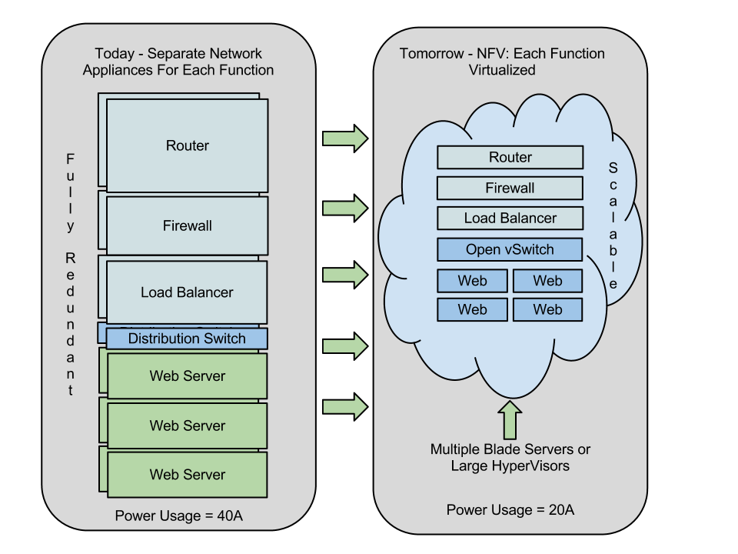
And Network Function Virtualization ?
Taken from: Pentalink Systems
MIDDLEBOXES: (Wikipedia)
A middle-box or network appliance is a computer networking device that transforms, inspects, filters, or
otherwise manipulates traffic for purposes other than packet forwarding
e.g. firewalls, NAT, Intrusion Detection Systems, Load Balancers, RAN, CDN etc.

Slide 5
SDN | NFV
Taken from: Overture Networks ‘2013
NFV can be realized using non-SDN mechanisms, relying on current techniques use in datacenters
However, SDN can enhance performance, simplify compatibility with existing deployments, and facilitate operation and maintenance procedures
NFV can support SDN by providing the infrastructure upon which the SDN software can be run

Slide 6
Motivation
Data Plane
Concerned with forwarding only
However, in addition to L2/L3 (e.g. NIC, router, switch) devices
Include wide range of network functions e.g firewalls, NAT, Load Balancers etc.
With NVF
hardware switching elements realized using software on generic compute platforms e.g. virtualNIC, load balancers
data plane now consists of :
pNIC, vNIC, some NVF(s) hosted on VMs, vSwitches in hypervisors, host and guest network stacks etc – “Sofware Dataplane” (SDP)
Effective data plane diagnosis
ping, traceroute, NetFlow etc. work well to analyze simple dataplanes
Software dataplanes pose new challenges
Similar tools not available

Slide 7
Challenges
Subtle performance problems
Misallocation of resources to SDP elements
Contention amongst elements for shared resources
Buggy design/implementation of software elements
Why different from previous ?
Hardware elements simpler to diagnose
they have few resources to worry about (bandwidth, buffering) compared to
CPU, disk, memory, network bandwidth etc. when hosted on VMs
Contention
could occur only at few locations e.g. buffer or link utilization overload
whereas in SDP can occur at many locations in virtualization stack
Also implementations bugs in hardware are rare
but we all know how software is written!

Slide 8
Approach
System for performance problems in SDP
Assumption: view SDP as a pipeline of elements (logical units) that interact using buffers or function calls
Abstraction covers variety of entities on software data path including middle-bix logic, routines in hypervisor and VM’s network stack
Statically analyze code paths of elements to find possible locations where packets can be dropped
Instrument (add counters to) such locations to collect statistics centrally
Use statistics for two kinds of diagnostic applications
different dimensions: across all VMs on a single machine including client VM or middleboxes
Across collection of middlebox VMs chained together (may be on different machines)

Slide 9
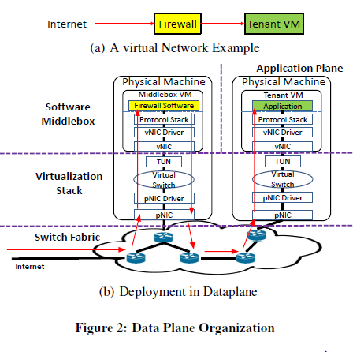
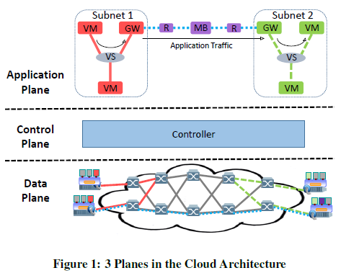
Settings
Focus on multi-tenant cloud data centers
Tenants deploy virtual private clusters consisting of application end-points or middleboxs and define their logical links
Notes:
Tenant wants all traffic through the firewall
2(B) configuration computed by the controller
Software data-paths of multiple tenants can overlap on one or more physical machines

Slide 10
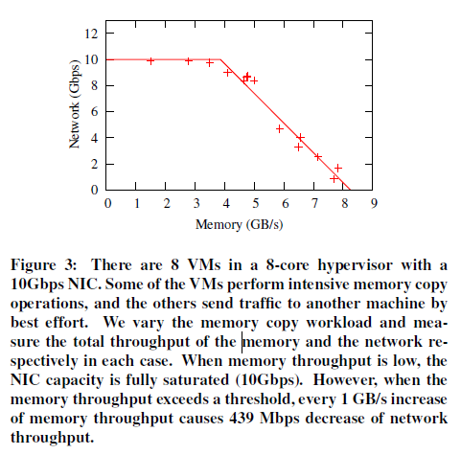
Accurate Diagnosis is Challenging
Traditional approaches
Resource utilization as an indicator of bottlenecks ?
Middlebox is a video transcoder with non-blocking IO – CPU utilization 100%
Monitor traffic volume changes
Change in traffic profile
Contention: difficult
Implementation bugs:
E.g. memory leaks in code
Cause propagation (chaining)

Slide 11
PerfSight: Architecture

Slide 12
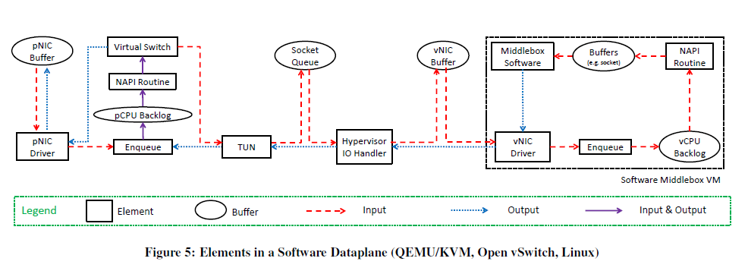
Sample System and Elements
QEMU: opensource hypervisor with hardware virtualization (using binary translation)
Open vSwitch : production-quality open-source implementation of a distributed virtual multilayer switch to provide a switching stack for hardware virtualization environments

Slide 13
Data Collection
Where ?
Each element has input output methods
Analyze code path that packet traverses from input → output
Determine possible branches that might drop it
Manual process currently
What ?
packet counter, byte counter, I/O time counter
I/O time can reveal starvation and help in detecting propagation issues
Aggregate statistics easily derived from above
How ?
use data where available e.g net_device for NIC, TAP, soft_net for NAPI
Elements in HV and middleboxes – design common API
Unified format
e.g. for NIC driver

Slide 14
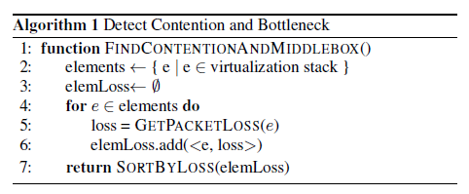
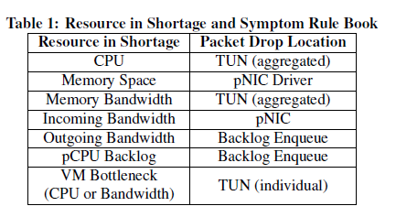
Diagnosis (1/2)
Contention and Bottleneck

Slide 15
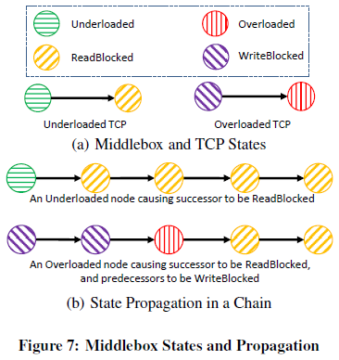
Diagnosis (2/2)
Propagation
Readblocked
Writeblocked
Candidate Middleboxes

Slide 16
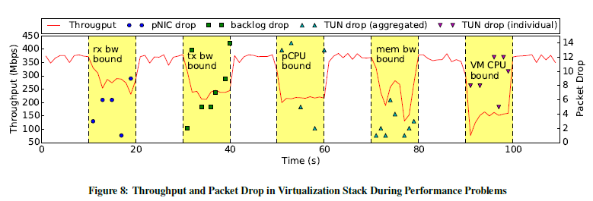
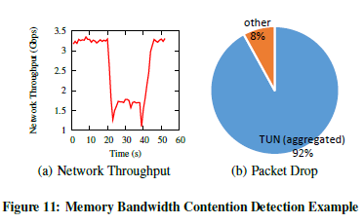
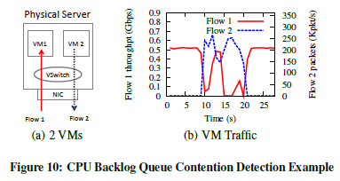
Evaluation (1/3)
Functional Evaluation
Notes:
To evaluate PerfSight, we set up a cluster with Dell T5500 servers,
each of which has 8 cores, 16GB memory and a 10Gbps NIC. Each
server runs Ubuntu with Linux kernel 3.2.

Slide 17
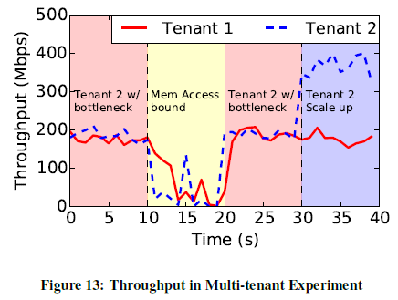
Evaluation (2/3)
Usecase: Multi-tenant scenario

Slide 18
Evaluation (3/3)

Slide 19
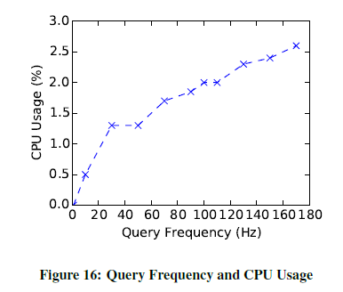
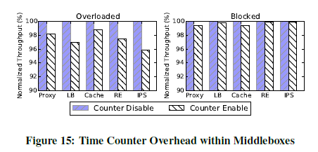
Feasibility
Overhead
Scalability
System is small - but claim it will scale since stats at each element
Diagnostic app takes O(n) [n = number of elements]
Ticket aggregation across cloud operators to diagnose overlapping elements

Slide 20
Q&A

